Slide 1


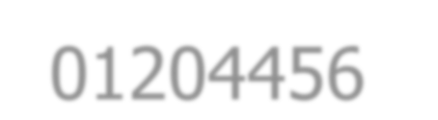







01204456 Social Networks Data Mining
Department of Computer Engineering Faculty of Engineering, Kasetsart University Bangkok, Thailand.

Slide 2


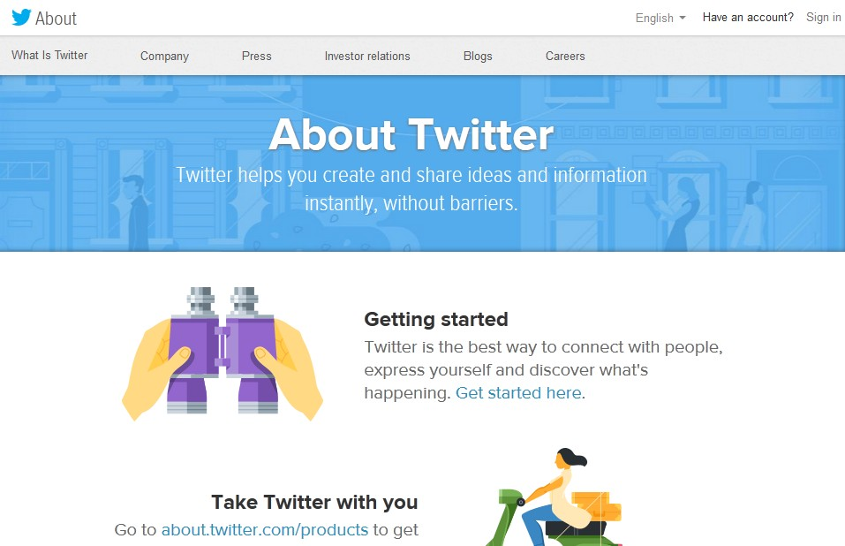


What is Twitter?
A free microblogging service
– Enable users to send and read messages, called tweets

Slide 3



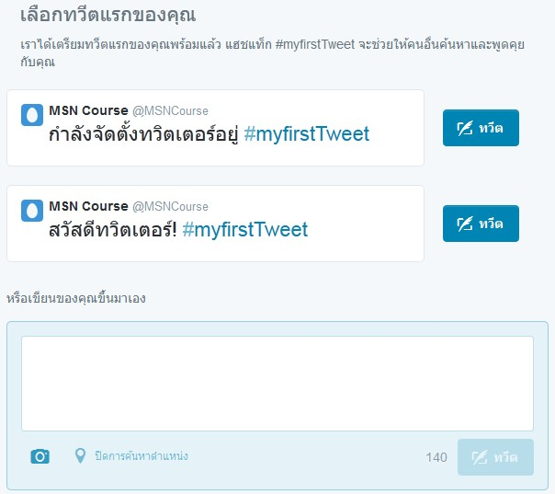
Tweets
Text-based posts of up to 140 characters:
Displayed on the author’s profile page, and
Delivered to the author’s subscribers who are known as followers
real-time
quick
simple

Slide 4


Founder of Twitter
Twitter was created in March 2006 by Jack Dorsey, Evan Williams, Biz Stone, and Noah Glass.

Slide 5

Terminology
Following – An action of subscribing to tweets from another persons
Followers – Persons who subscribe to your tweet
Tweet – A message on Twitter
RT – Retweet (or re-send) a message that a person has posted on Twitter
@Reply – A public message sent from one person to another
DM – A short non-public direct message sent between two persons
Hashtag – A keyword allowed to be easily searched and located

Slide 6

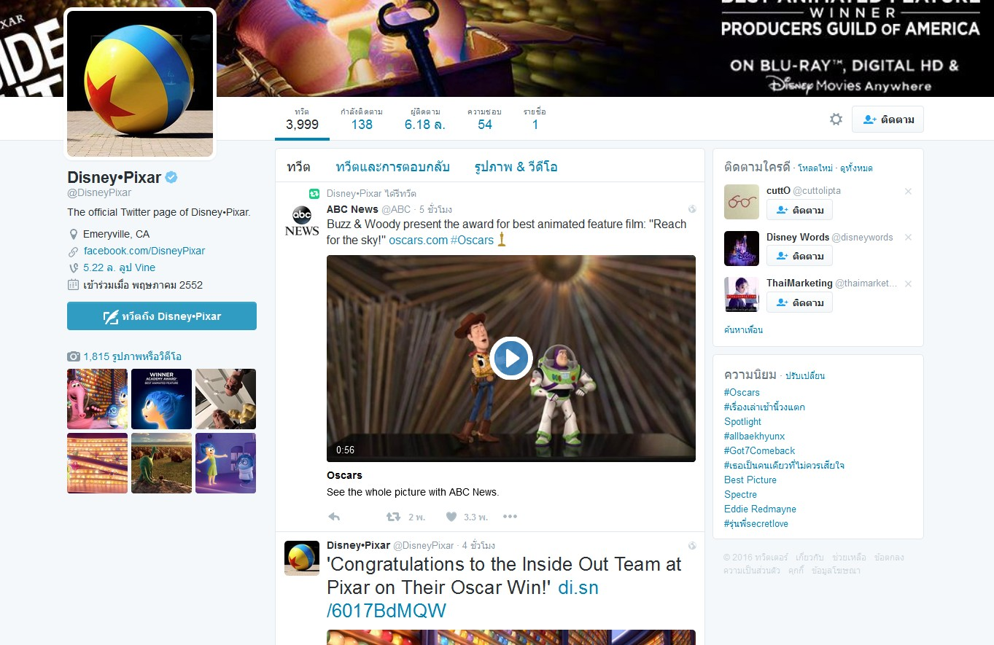


screen name
profile
hashtag

Slide 7


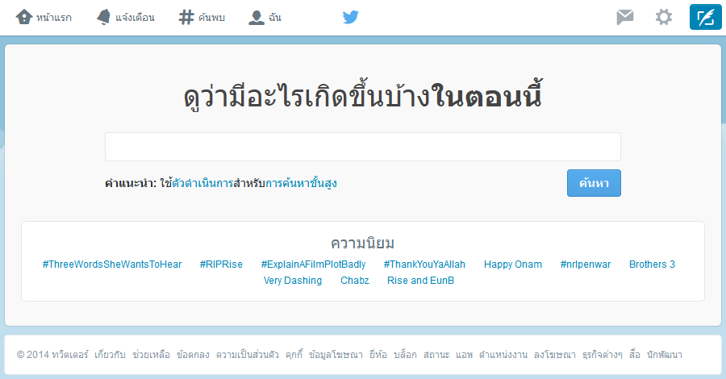
Search and Trends
Website: https://twitter.com/search-home

Slide 8


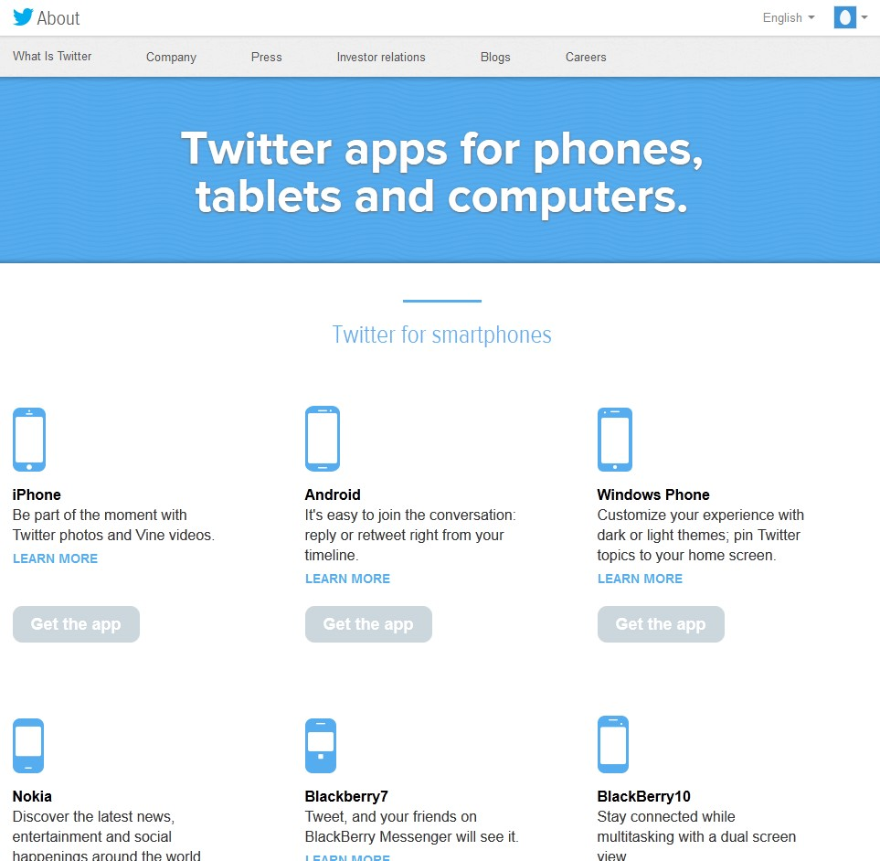


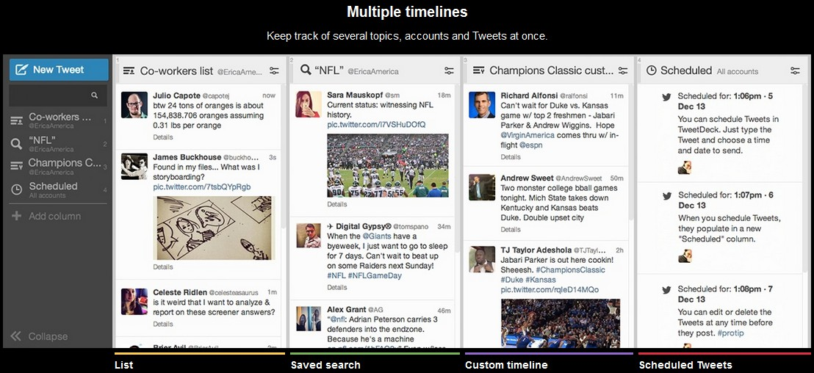
Twitter Applications
TweetDeck
Website: https://about.twitter.com/products/list

Slide 9



Slide 10
Types of Information (can be explored)
Information about a user
Friends & followers of a user
Tweets published by a user
Search results on Twitter
Place & geo
10

Slide 11

Twitter API
Representational State Transfer (REST) APIs
Simple interfaces for most Twitter functionality, e.g.,
read / write tweets, DM
search trends
collect information of a user, followers
Streaming APIs
A family of powerful real-time APIs for tweets and other social events

Slide 12



Twitter Developers
Website: https://dev.twitter.com

Slide 13


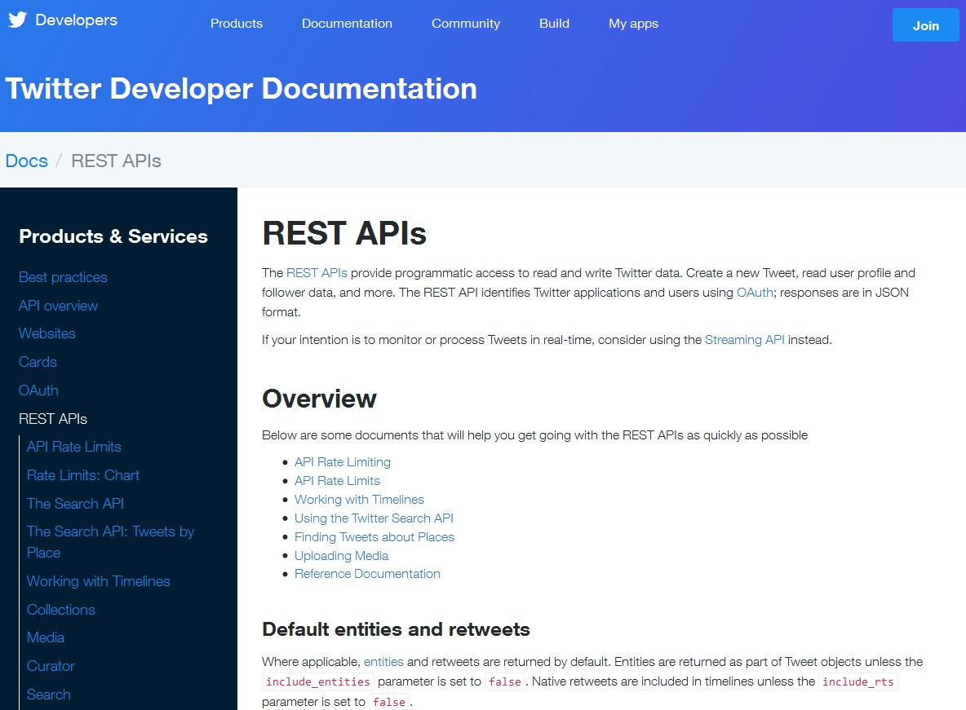
REST APIs Documentation
Website: https://dev.twitter.com/rest/public

Slide 14


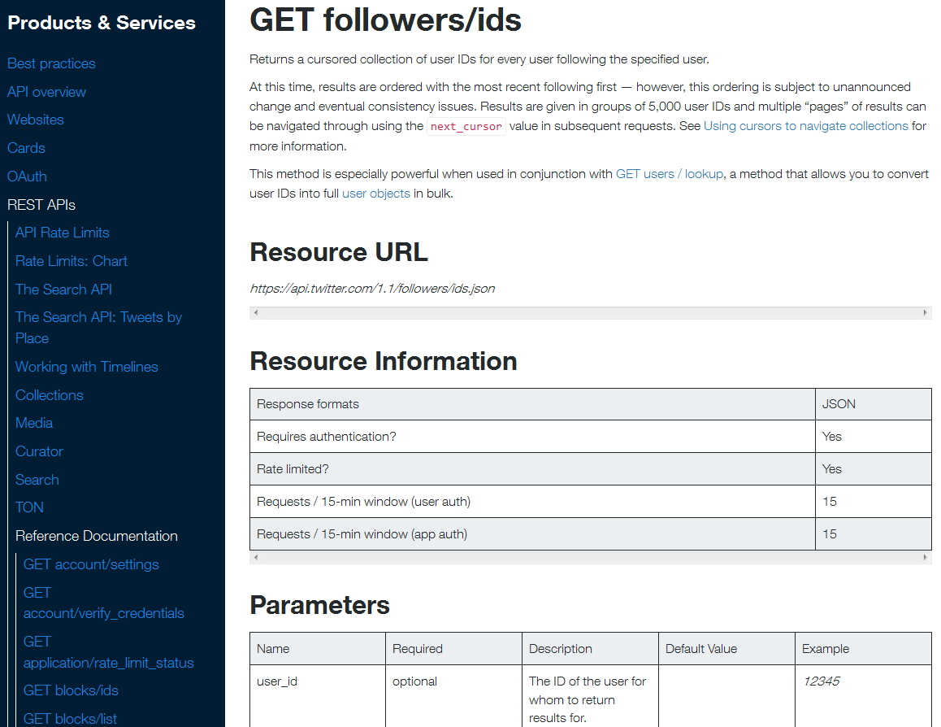
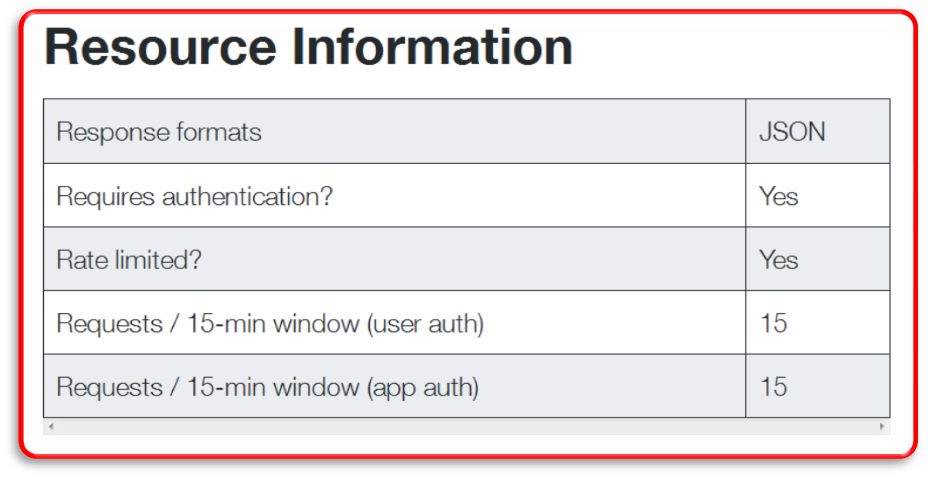
Rate Limits
In API version 1.1:
Window: 15 minutes
User limit: 15 requests per user
App limit: 15 requests per app.
Authentication is required
Website: https://dev.twitter.com/rest/public/rate-limits

Slide 15





API 1.1’s Authentication
Use OAuth to provide authorized access to APIs
Secure: not required to share users’ passwords with 3rd party applications
Standard: a wealth of client libraries and example codes
Authentication models
Application-user authentication
Most common form of resource authentication
Require both an application (i.e., consumer key) and a granted permission (i.e., access token) identities
Application-only authentication
Issue authenticated requests on behalf of the application itself, without a user context
Some APIs are not supported (e.g., search users, post tweets, etc.)

Slide 16


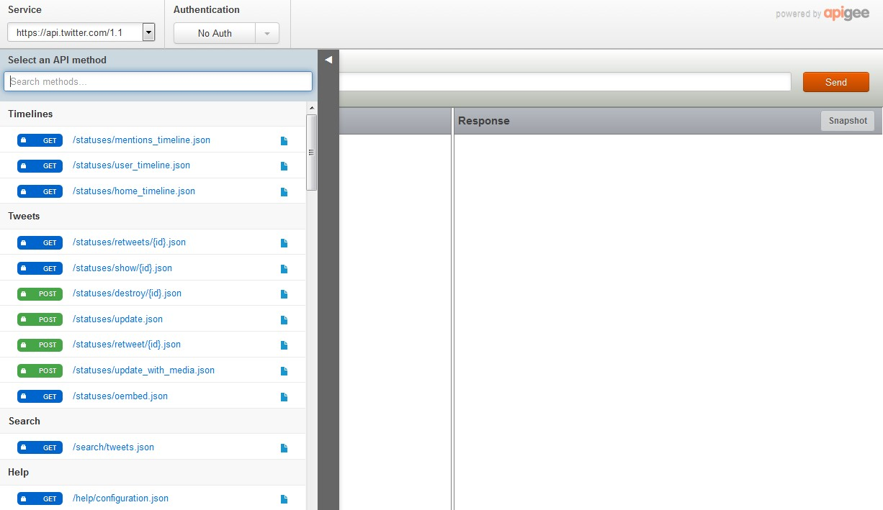
Developer API Console
Website: https://dev.twitter.com/rest/tools/console

Slide 17

API Examples
GET followers/ids
e.g., https://api.twitter.com/1.1/followers/ids.json?
screen_name=chronolf&cursor=-1&count=100
screen_name/user_id
The screen_name/user_id of the user for whom to return results for.
cursor
Cause the list of connections to be broken into pages of no more than 5000 IDs at a time.
If no cursor is provided, a value of -1 (first page) will be assumed.
stringify_ids
Many programming environments will not consume our Tweet IDs due to their size. Provide this option to have IDs returned as strings instead.
count
Specify the number of IDs attempt retrieval, up to 5000 per request.

Slide 18

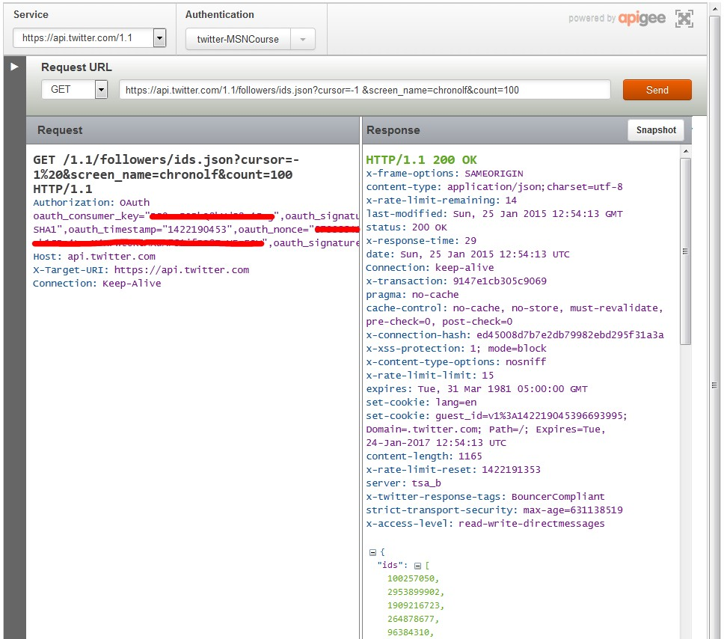
Exploring the Twitter API
OAuth 1
user limit
{
output
"ids": [ 100257050,
2953899902,
1909216723,
. . . <truncated> 1588773776,
390950920,
371185751
],
"next_cursor": 1443144968453158000,
"next_cursor_str": "1443144968453157950",
"previous_cursor": 0,
"previous_cursor_str": "0"
}

Slide 19
API Examples
GET friends/ids
e.g., https://api.twitter.com/1.1/friends/ids.json?
screen_name=chronolf&cursor=-1&count=100
GET users/show
e.g., https://api.twitter.com/1.1/users/show.json?
screen_name=chronolf
{
"id": 30634976,
"id_str": "30634976", "name": "Shade", "screen_name": "chronolf",
"location": "Ikoma-shi, Nara",
"description": "M1 student. Tweet about life, Japanese-related things, games and technology. STFX12, KU71, E67, CPE25. Now playing #FF14, #パズド ラ, #グラブル.",
"url": "http://t.co/SvPGYBVw6p",
. . . <truncated>
}

Slide 20





20

Slide 21


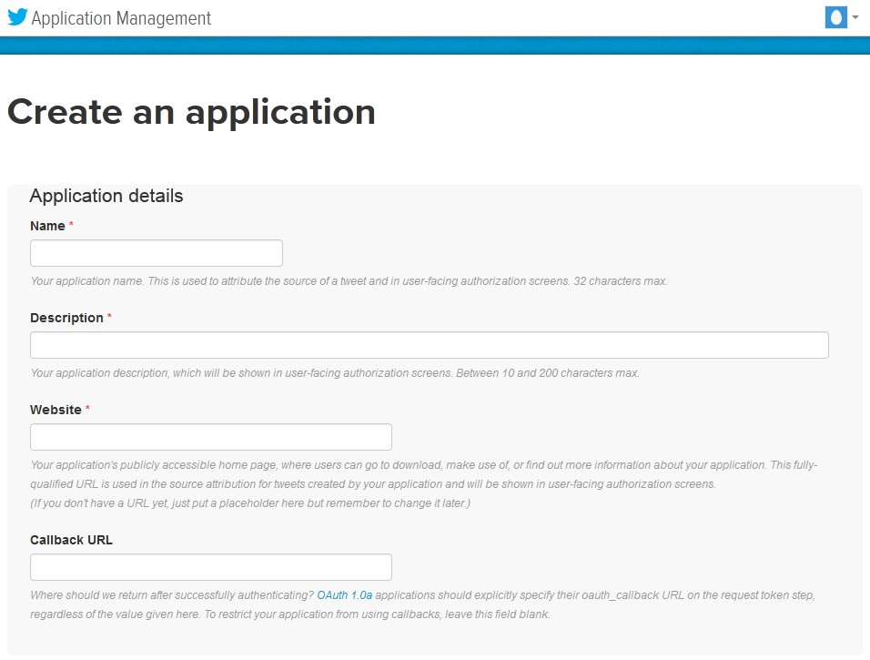
Create an Application
Website: https://apps.twitter.com

Slide 22


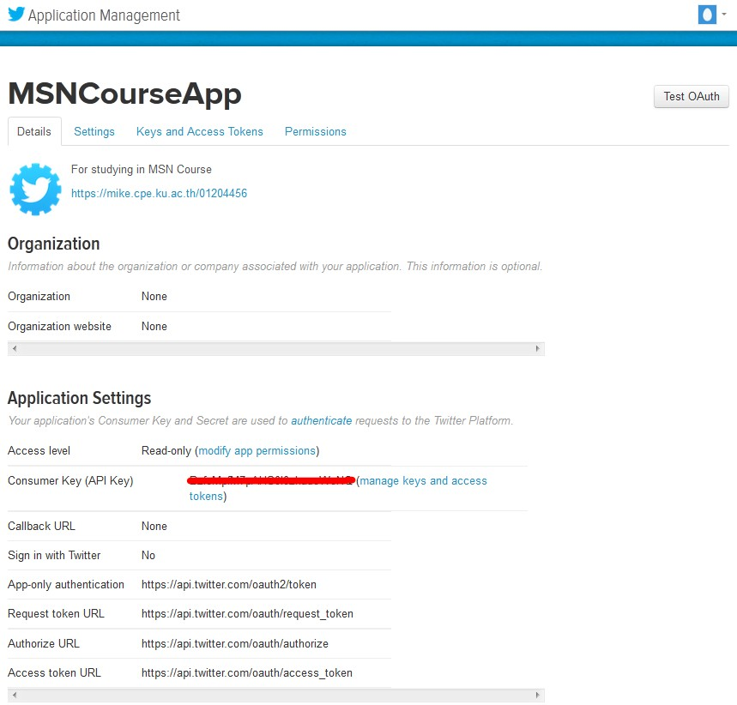

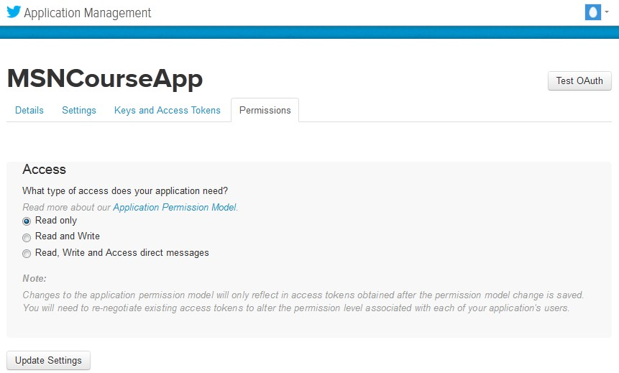

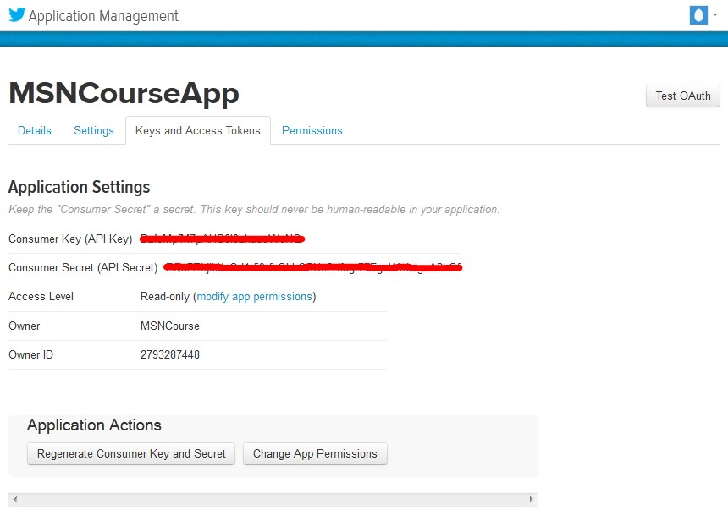
Application Details

Slide 23


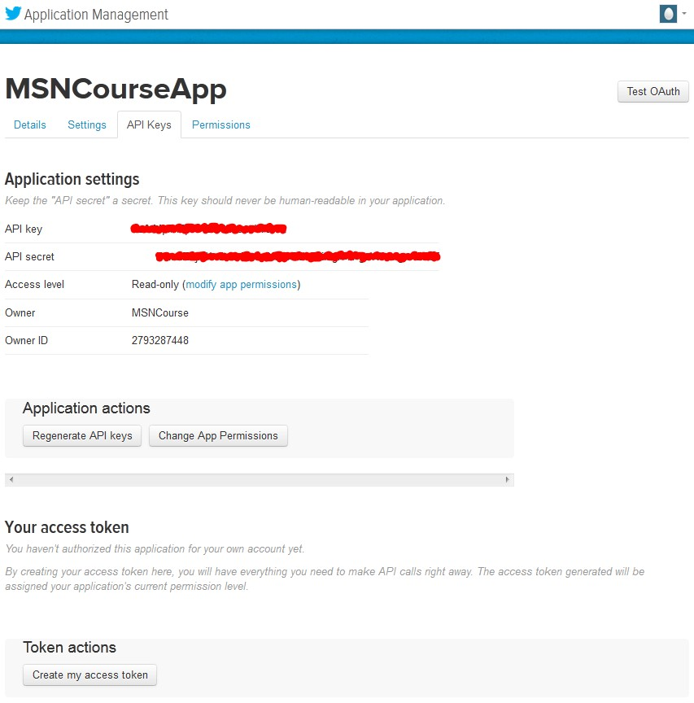
Creating an Access Token

Slide 24


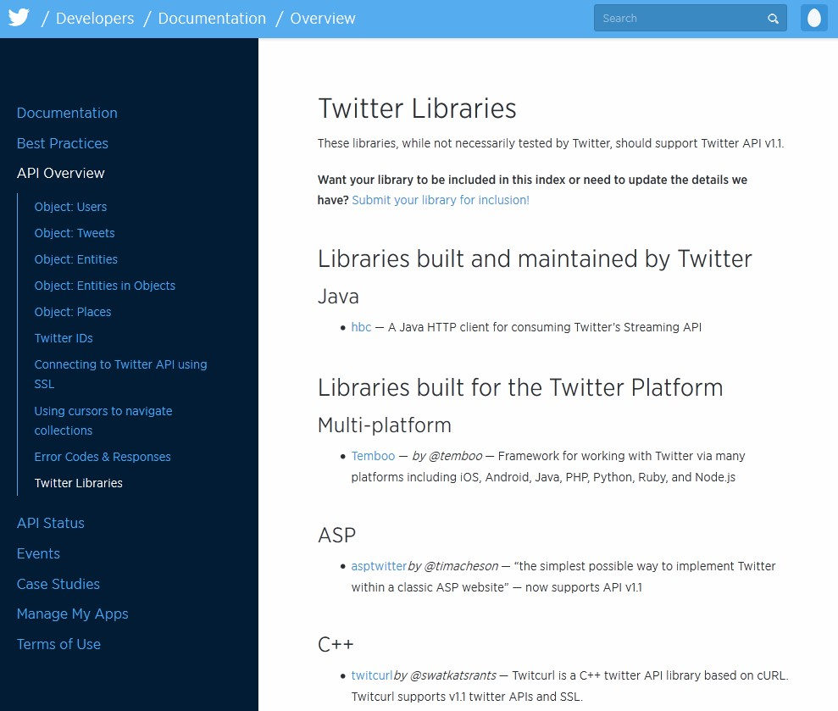


Twitter Libraries
ActionScript/Flash C++
Clojure Erlang Java JavaScript
.NET
Objective-C/Cocoa Perl
PHP
Python Ruby Scala
Website: https://dev.twitter.com/overview/api/twitter-libraries

Slide 25


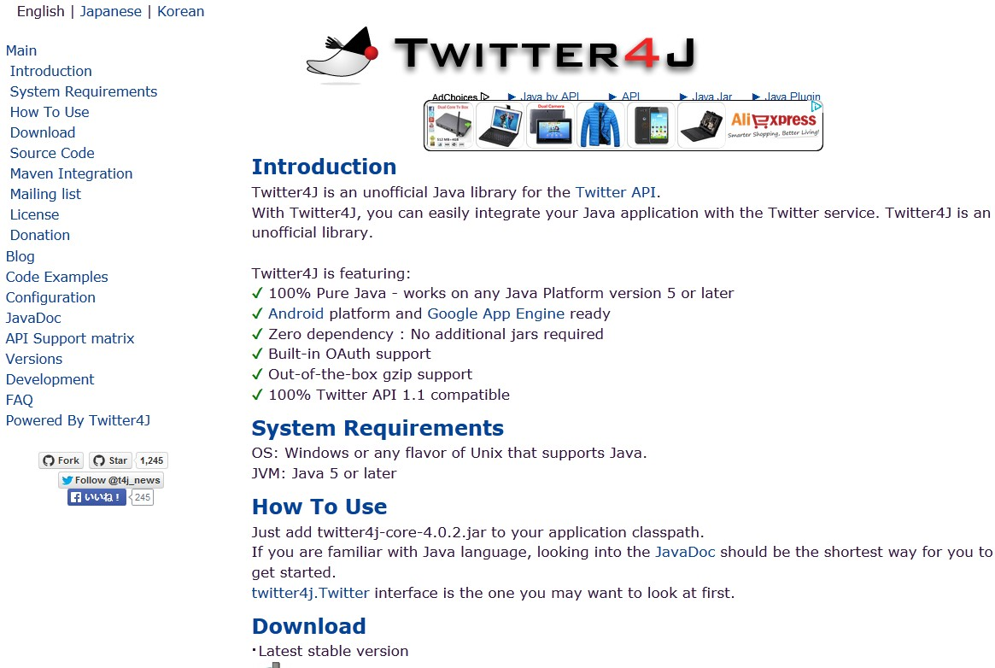
Twitter4J
An unofficial Java library for the Twitter API
Easy integration between a Java App and the Twitter service
100% pure Java – work on Java Platform version 5 or later
Built-in OAuth support
Compatible with Twitter API 1.1
Website: http://twitter4j.org

Slide 26



How to Use Twitter4J
Download the latest stable version
Add twitter4j-core-version.jar to application classpath
JavaDoc
– http://twitter4j.org/javadoc/index.html

Slide 27

Depicting User Relationship
Users follow their interests on Twitter through both one- way and mutual following relationships.
Friends: persons whom you are followed
Followers: persons who follow you
Use a family of GET friends/… and GET followers/… to retrieve and depict the relationship

Slide 28



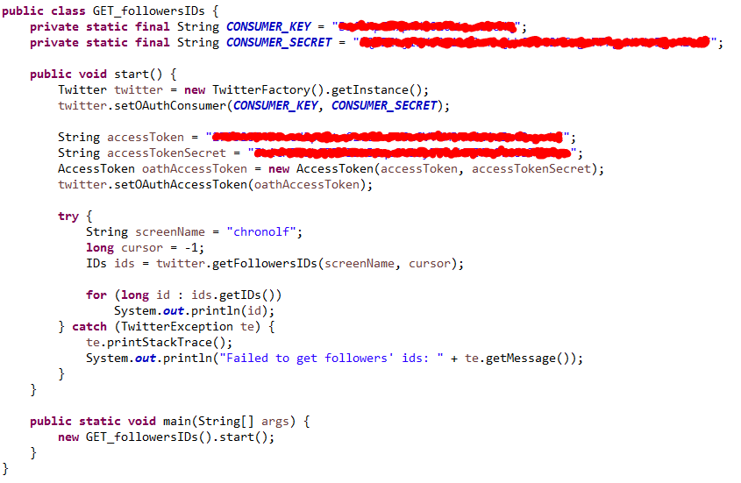
GET followers/ids Code Sample
1:
2:
3:
4:
5:
6:
7:
8:
9:
10:
11:
12:
13:
14:
15:
16:
17:
18:
19:
20:
21:
22:
23:
24:
25:
26:
27:
28:
29:
30:

Slide 29

Exploring Trending Topics
Ask Twitter for the topics that are currently trending worldwide (or more specific locales)
Constrain via Yahoo! GeoPlanet’s Where On Earth (WOE) ID system:
A way to map a unique identifier to any name place on Earth
e.g., world’s WOEID = 1, Bangkok’s WOEID = 1225448
http://www.woeidlookup.com
However, the trending topics are cached for 5 minutes.
Don’t need more frequently requests

Slide 30


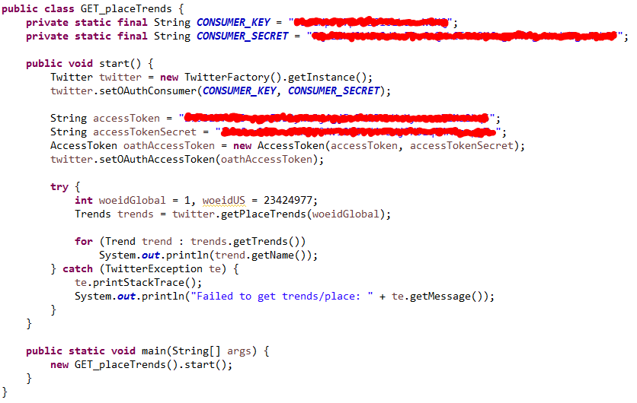
GET trends/place Code Sample
1:
2:
3:
4:
5:
6:
7:
8:
9:
10:
11:
12:
13:
14:
15:
16:
17:
18:
19:
20:
21:
22:
23:
24:
25:
26:
27:
28:
29:
30

Slide 31

Searching for Tweets
Fetch some tweets associated with a hashtag for further analysis
Use GET search/tweets resource for a particular query of interest

Slide 32


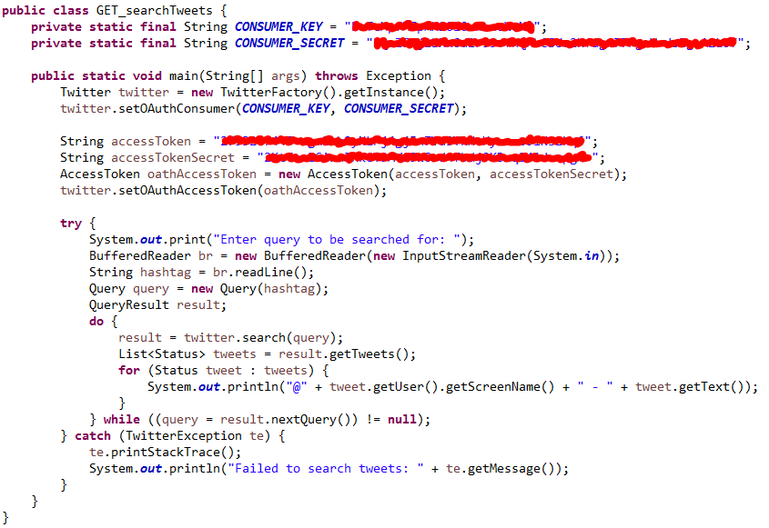

GET search/tweets Code Sample
1:
2:
3:
4:
5:
6:
7:
8:
9:
10:
11:
12:
13:
14:
15:
16:
17:
18:
19:
20:
21:
22:
23:
24:
25:
26:
27:
28:
29:
30:
31:
32:

Slide 33


